Slide 1
Breast Cancer Classification/Detection
Muhammad Adil
Ahmad Arrabi
Farzana Akhter
Cam Lunn

Slide 2
Content
01. Introduction
02. Dataset
03. Classification
04. Segmentation
05. Future Work Possibilities

Slide 3
Introduction
Cancer starts when cells begin to grow out of control.
Breast cancer is the SECOND MOST common cause of death from cancer in women in the United States after lung cancer.
Breast cancer occurs almost entirely in women, but men can get breast cancer, too.
In the last 30 years, doctors have made great strides in early diagnosis and treatment of the disease and in reducing breast cancer deaths.

Slide 4
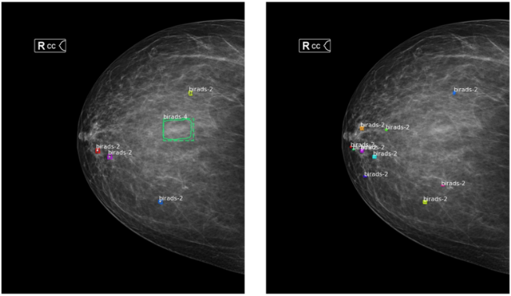
Aim of the Project
Develop an AI-based system to assist the early breast cancer detection
1. Classification : AlexNet
2. Segmentation : Mask R-CNN
Early breast cancer screening data as mammograms will be used for the modeling

Slide 5
Dataset
CBIS-DDSM data – following characteristics
Name | CBIS-DDSM
Abnormalities | Masses – Calcification – Nipple Retraction – Skin Thickening
Image Format | DICOM
Image Resolution | Not Fixed - Varies
Utilization | Classification / Localization / Segmentation
Target Labels | Flexible – Can be all the abnormalities or just benign/malignant

Slide 6
Classification

Slide 7
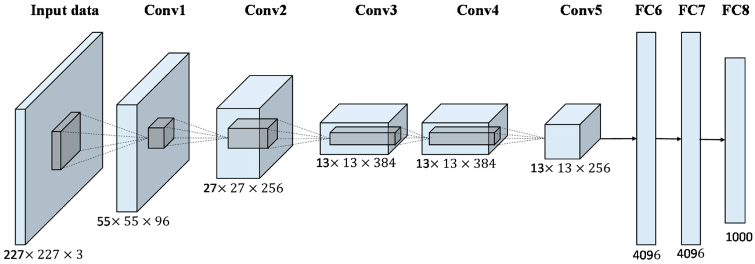
AlexNet (Pretrained)

Slide 8
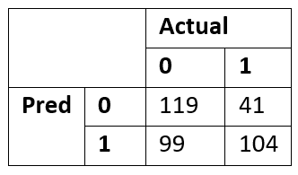
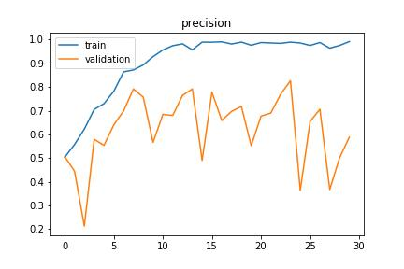
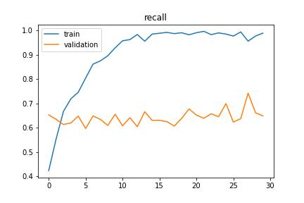
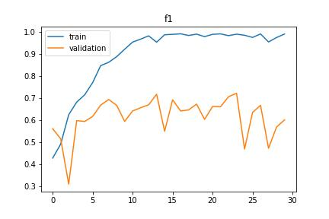
Results (Pretrained AlexNet)
Overfit badly on the validation set
Low accuracy on the test set
F1 score = 0.60
Precision = 0.51
Recall = 0.71
Accuracy = 0.61

Slide 9
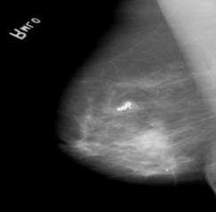
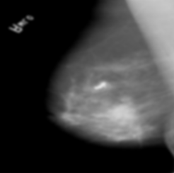
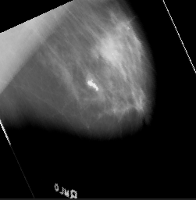
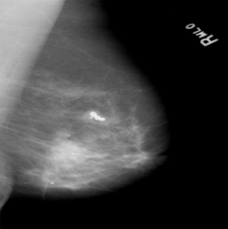
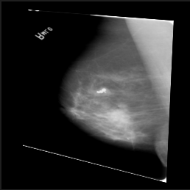
Augmentation
artificially increasing the training set by creating modified samples of the dataset
We used random gaussian blurring, perspective transformation, horizontal flipping, and rotation
Original
Gaussian Blur
Random rotation
Horizontal Flipping
Perspective Transformation

Slide 10
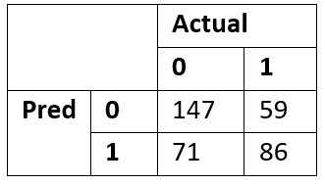
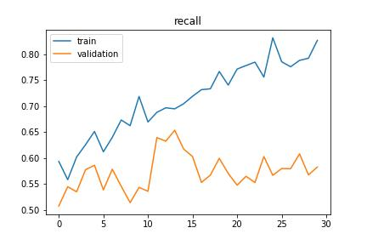
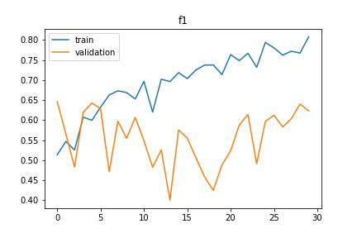
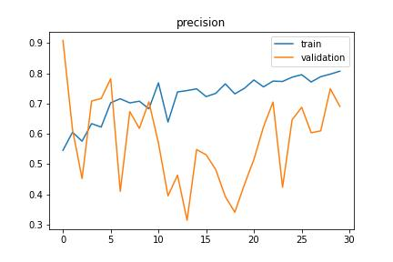
Results (Pretrained AlexNet + augmentation)
Randomly adding gaussian blur with the perspective transformation
Overfitting reduced but still apparent
F1 score = 0.57
Precision = 0.55
Recall = 0.59
Accuracy = 0.64

Slide 11
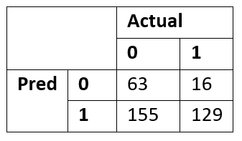
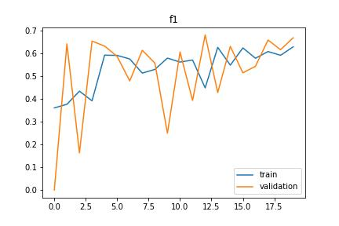
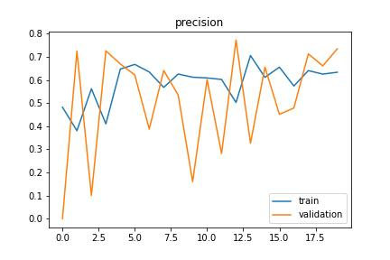
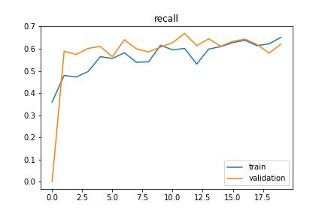
Results (Pretrained AlexNet + augmentation)
Randomly applying horizontal flipping and rotation
Solved Overfitting! but the training was a bit unstable
F1 score = 0.60
Precision = 0.45
Recall = 0.90
Accuracy = 0.53
This model has the lowest false negative rate

Slide 12
Using Pretrained AlexNet as a feature extractor
Remaining problems:
The most effective CNN-classifier just predicts image as malignant (78%)
High recall, but mediocre accuracy, precision, and f1 score
Implementing machine learning classifiers using pre-trained, augmented weights from horizontal flipping and rotations:
PCA-SVM hybrid
SVM
Do we need all the fully connected layers?
Overfitting to noise in training data?

Slide 13
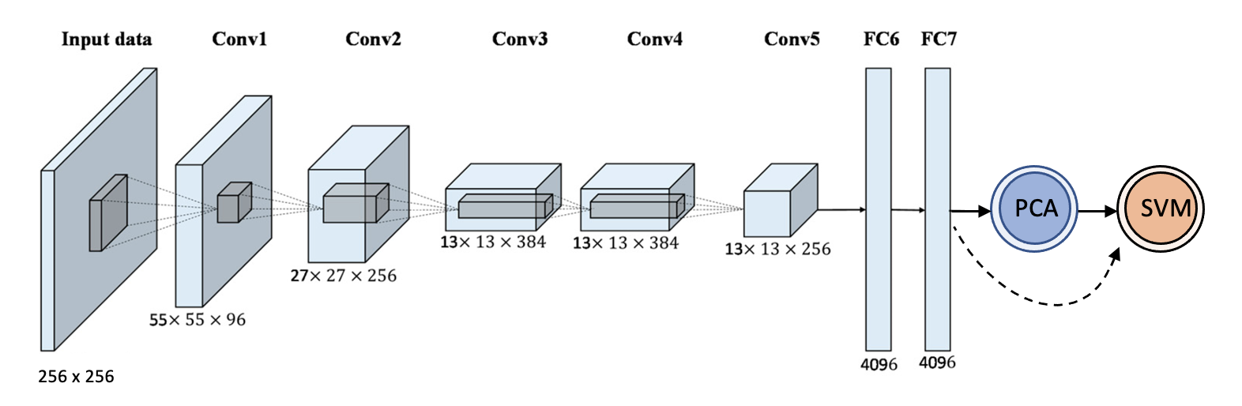
Full Pretrained AlexNet → PCA → SVM
A
P(Y = 1 | X)
B
**Trained weights from horizontal flipping and rotation loaded onto network

Slide 14
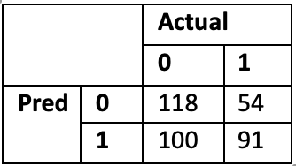
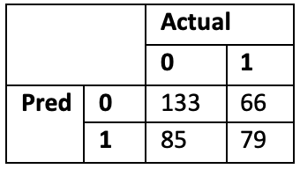
Results (Full Pretrained AlexNet → PCA → SVM)
A
B
PCA → SVM
SVM
F1 score = 0.54
Precision = 0.48
Recall = 0.63
Accuracy = 0.58
F1 score = 0.51
Precision = 0.48
Recall = 0.55
Accuracy = 0.58
**Principal Components = 100 | Polynomial kernel | FC7 as input | 80/20 train/test split

Slide 15
Truncated Pretrained AlexNet → PCA → SVM
A
P(Y = 1 | X)
B
**Trained weights from horizontal flipping and rotation loaded onto network

Slide 16
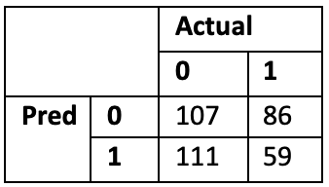
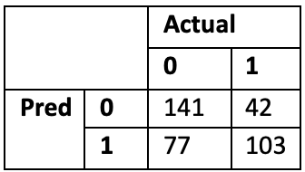
Results (Truncated Pretrained AlexNet → PCA → SVM)
A
B
PCA → SVM
SVM
F1 score = 0.37
Precision = 0.34
Recall = 0.40
Accuracy = 0.45
F1 score = 0.63
Precision = 0.57
Recall = 0.71
Accuracy = 0.67
**Principal Components = 100 | Polynomial kernel | FC6 as input | 80/20 train/test split

Slide 17
Best Performing Classifiers
CNN
SVM
F1 score = 0.60
Precision = 0.45
Recall = 0.90
Accuracy = 0.53
Minimizes false negatives
Uses complete network (7 layers)
F1 score = 0.63
Precision = 0.57
Recall = 0.71
Accuracy = 0.67
More balanced
Uses truncated network (6 layers)

Slide 18
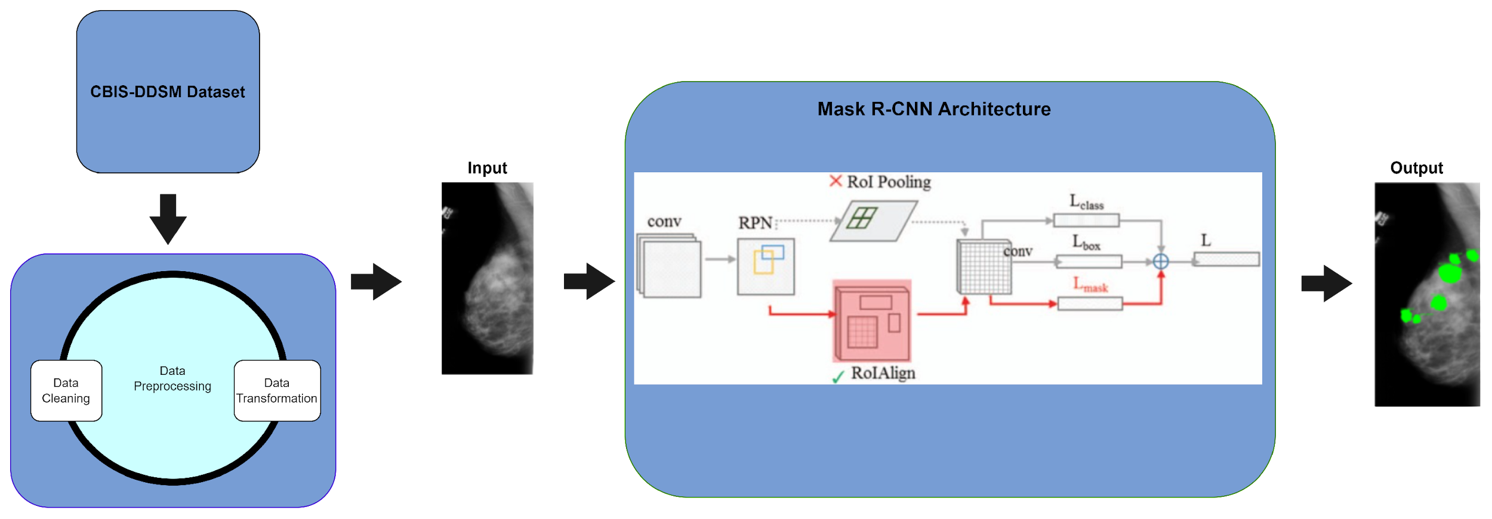
Segmentation
Image segmentation is the process of classifying individual pixels.
We used Mask R-CNN to segment the individual abnormalities in the image.

Slide 19
Implementation Details
Both Models –(Mass, Calcification) are implemented using PyTorch
Models are trained for 30 Epochs – with 587 for training and 200 for validation steps
The default architecture – Resnet 101 is used for the backbone
Most of the parameters were kept the same – (as of default values)
The pretraining weights – MS Coco – were used as an initialization
The best-performing weights are used for the inference.

Slide 20
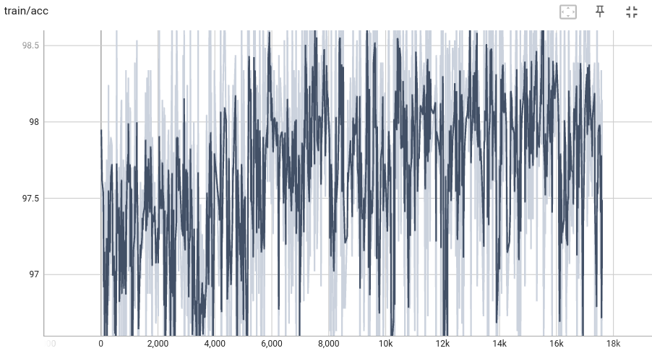
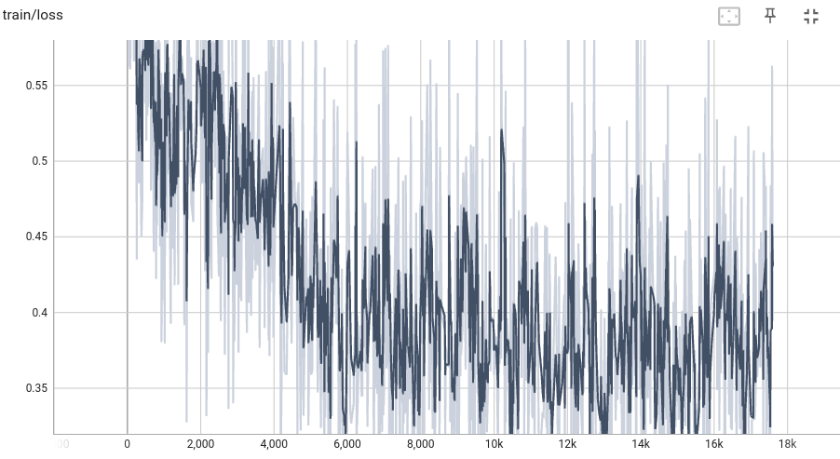
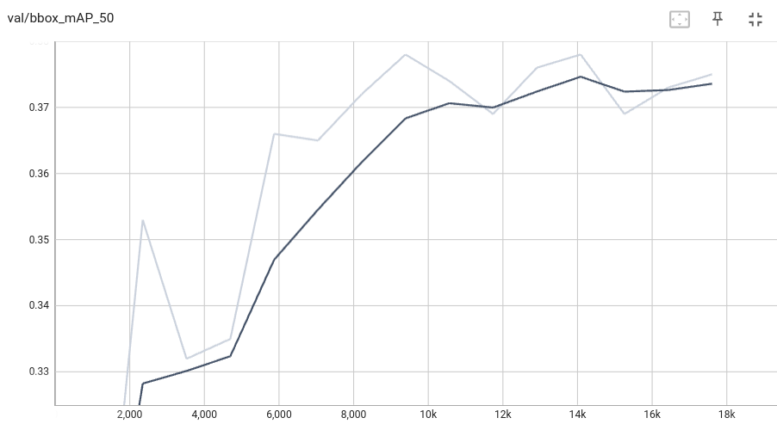
Results – Mass Model

Slide 21
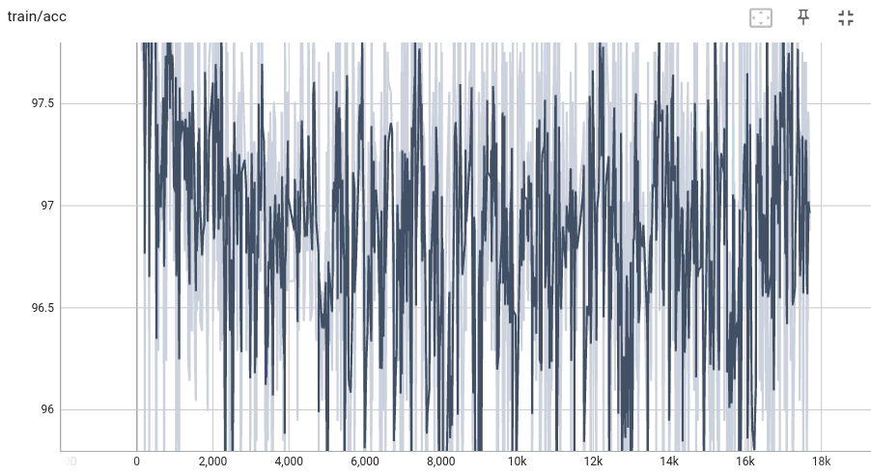
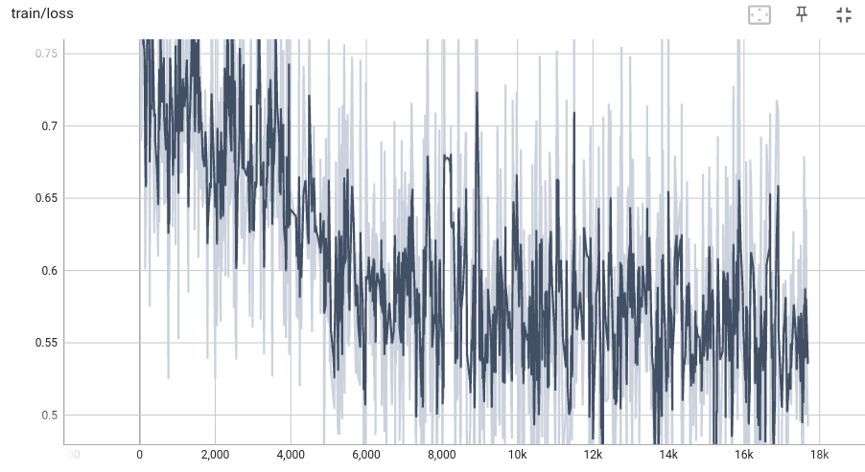
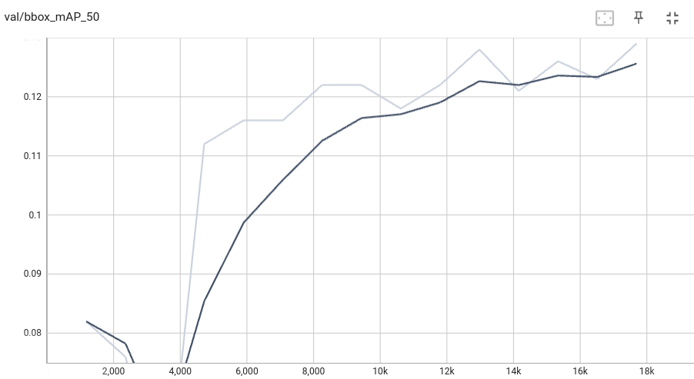
Results – Calcification Model

Slide 22
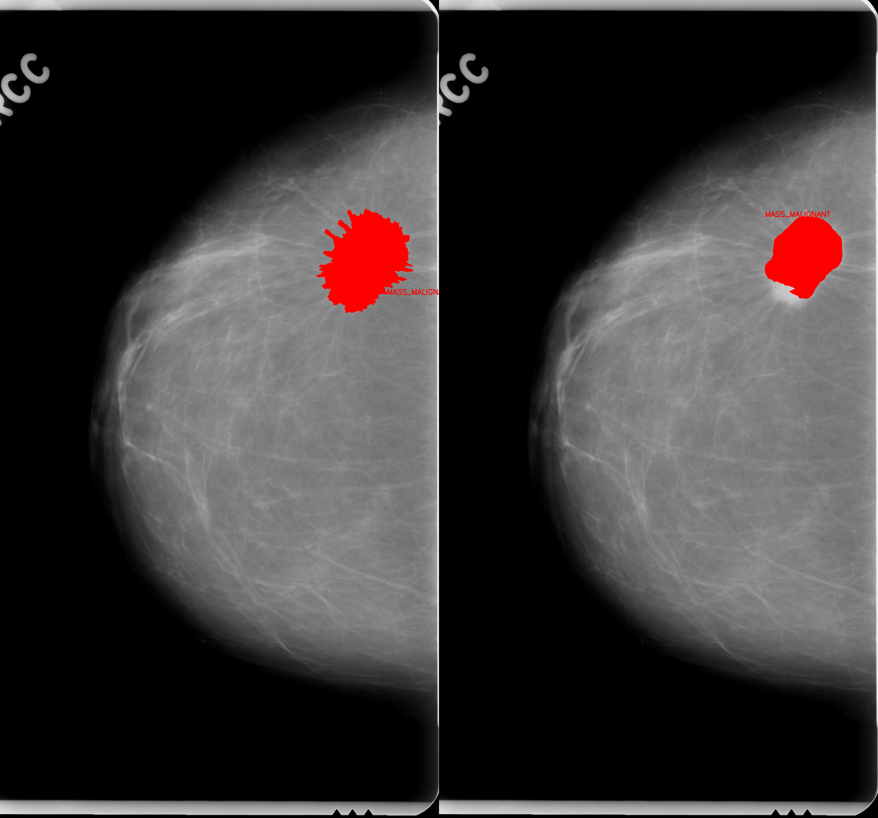
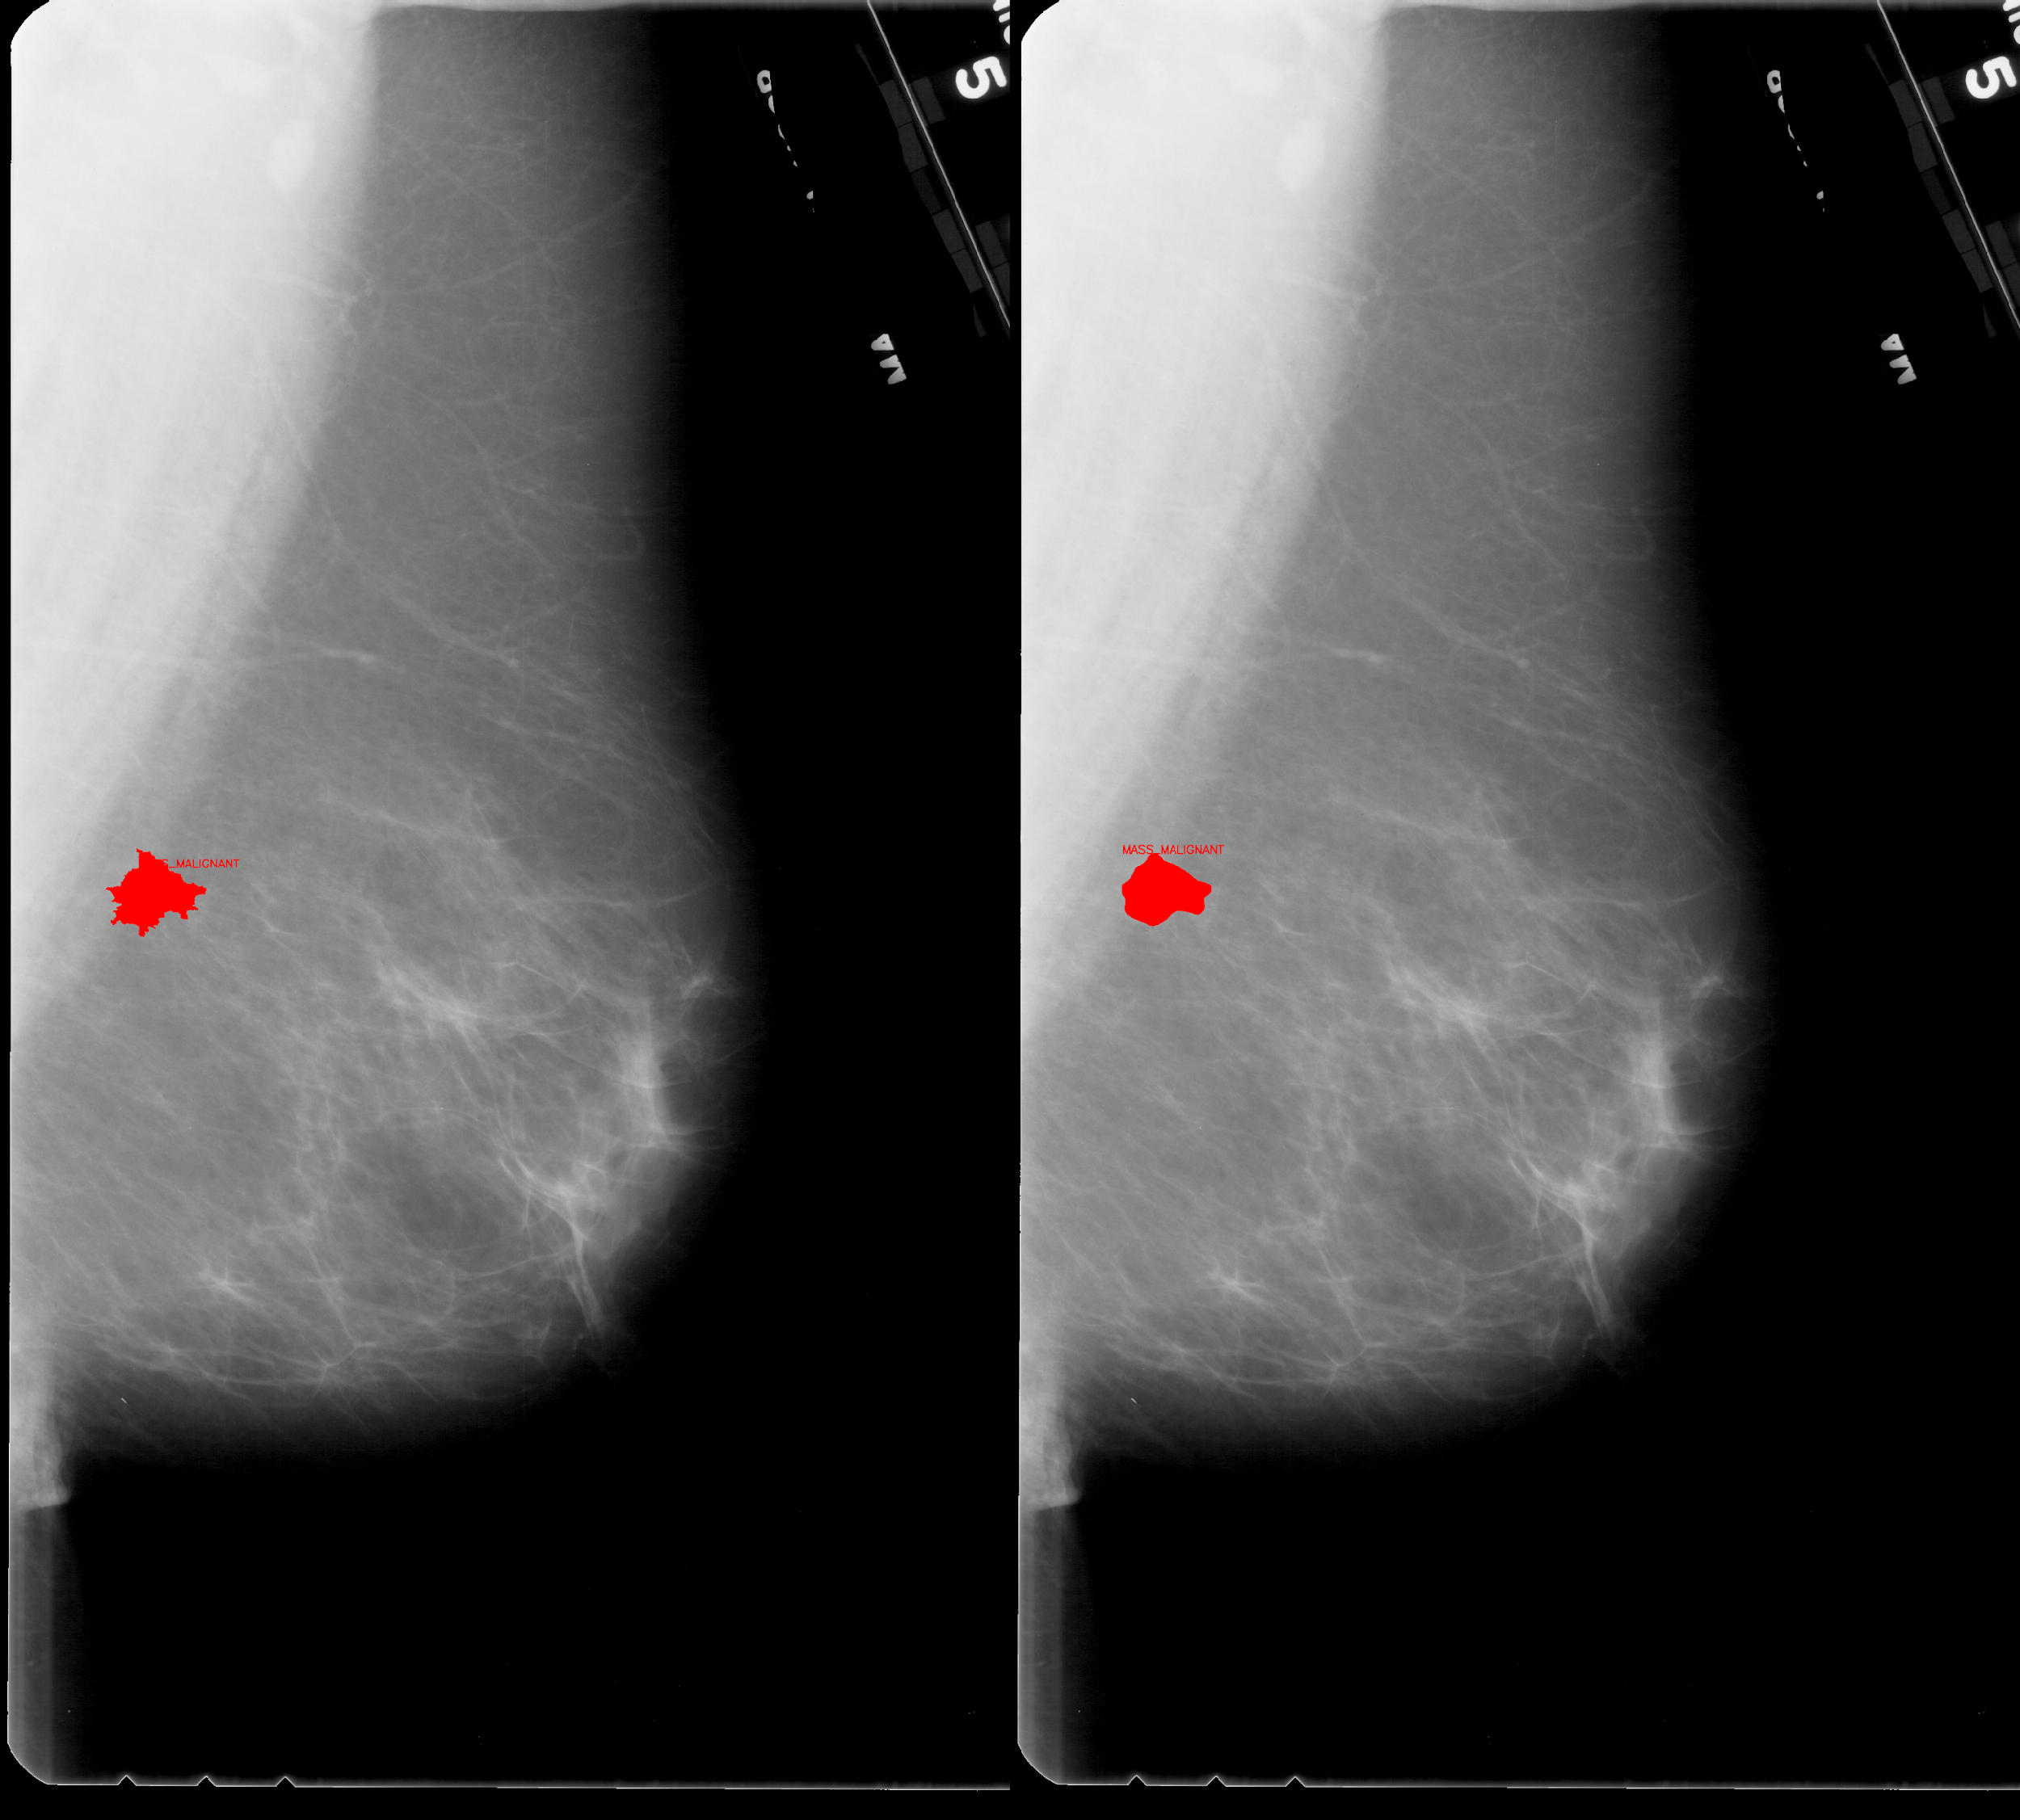
Results – Visualization

Slide 23
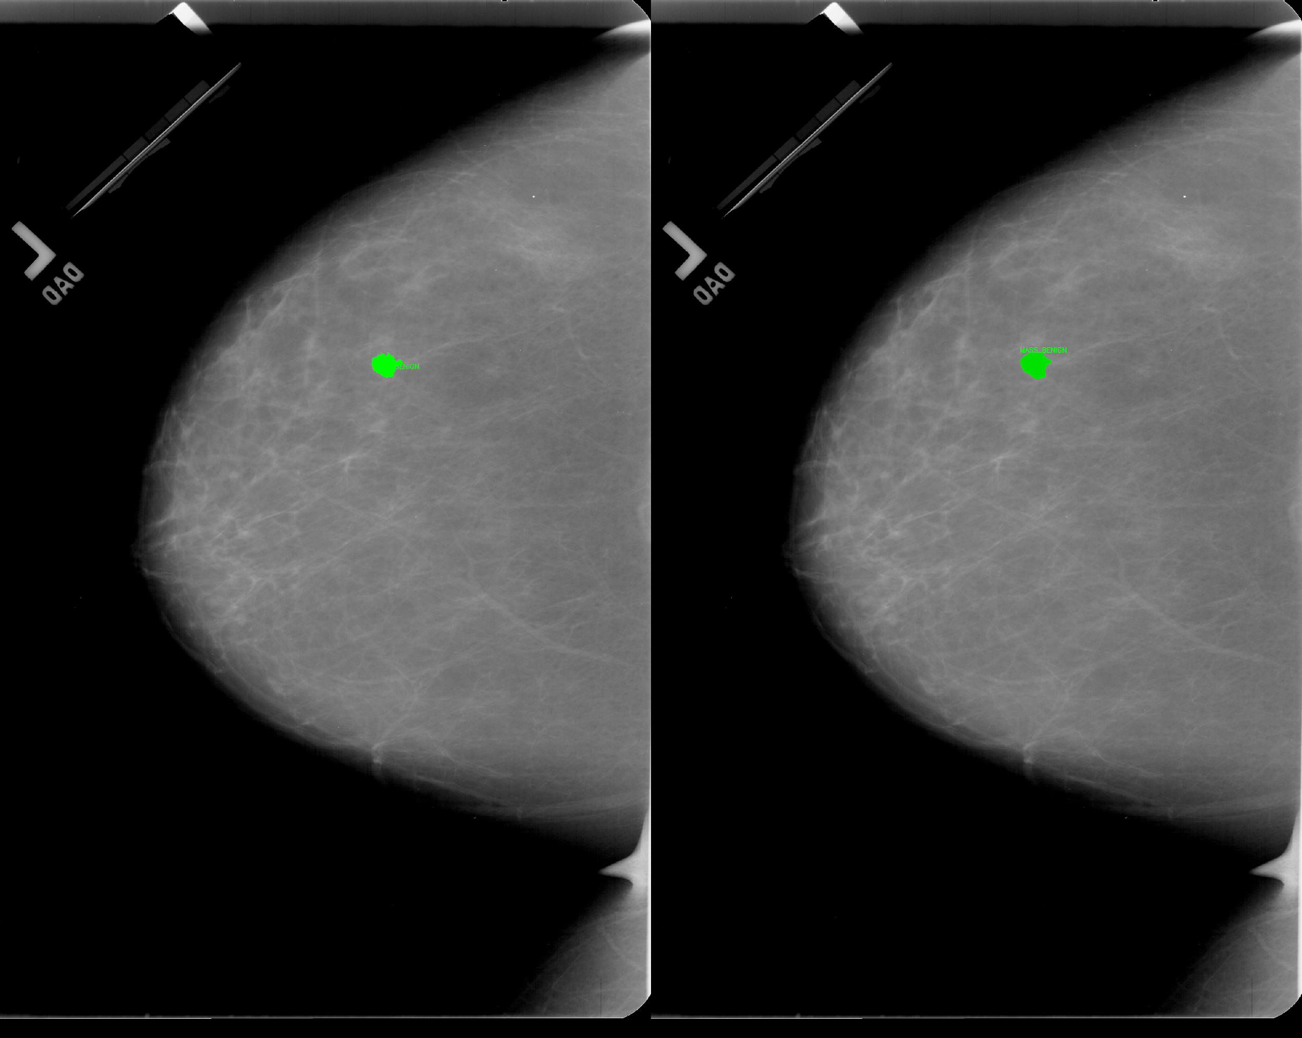
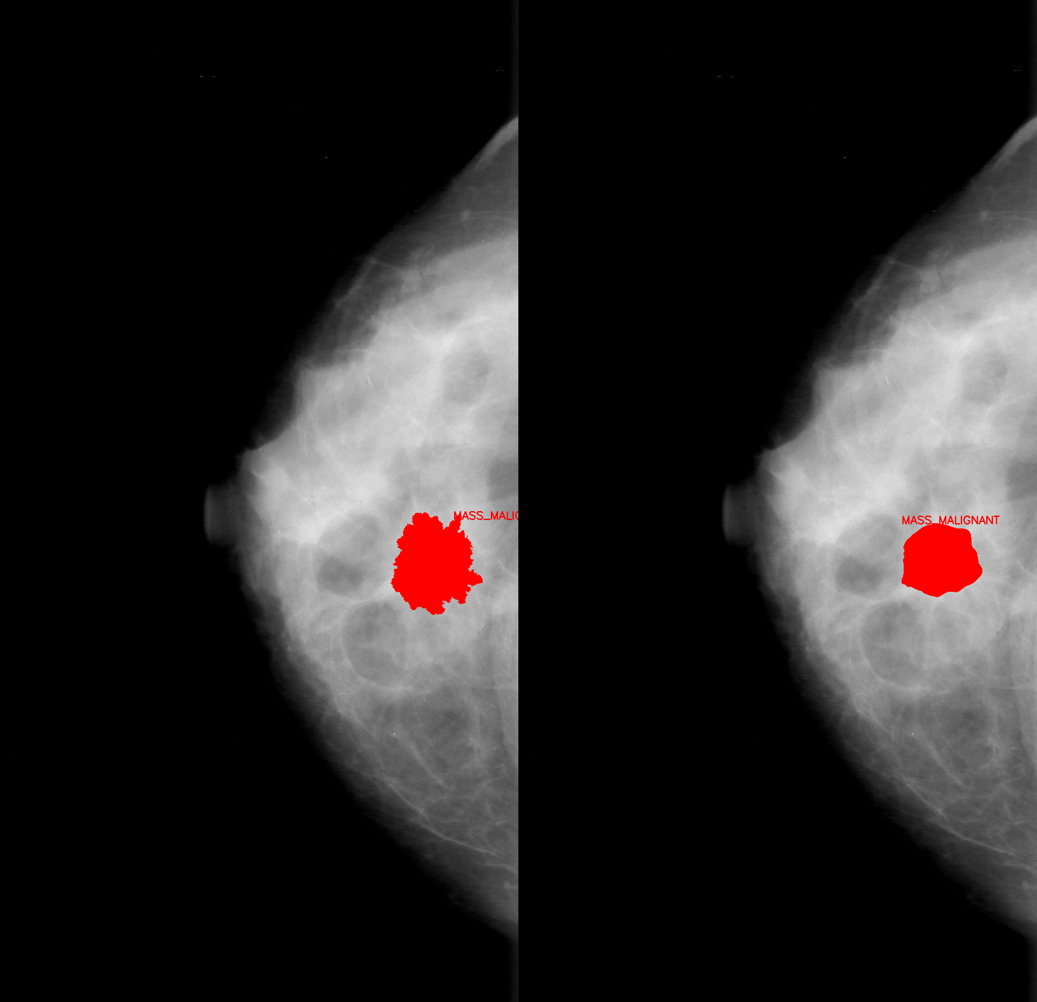
Results – Visualization

Slide 24
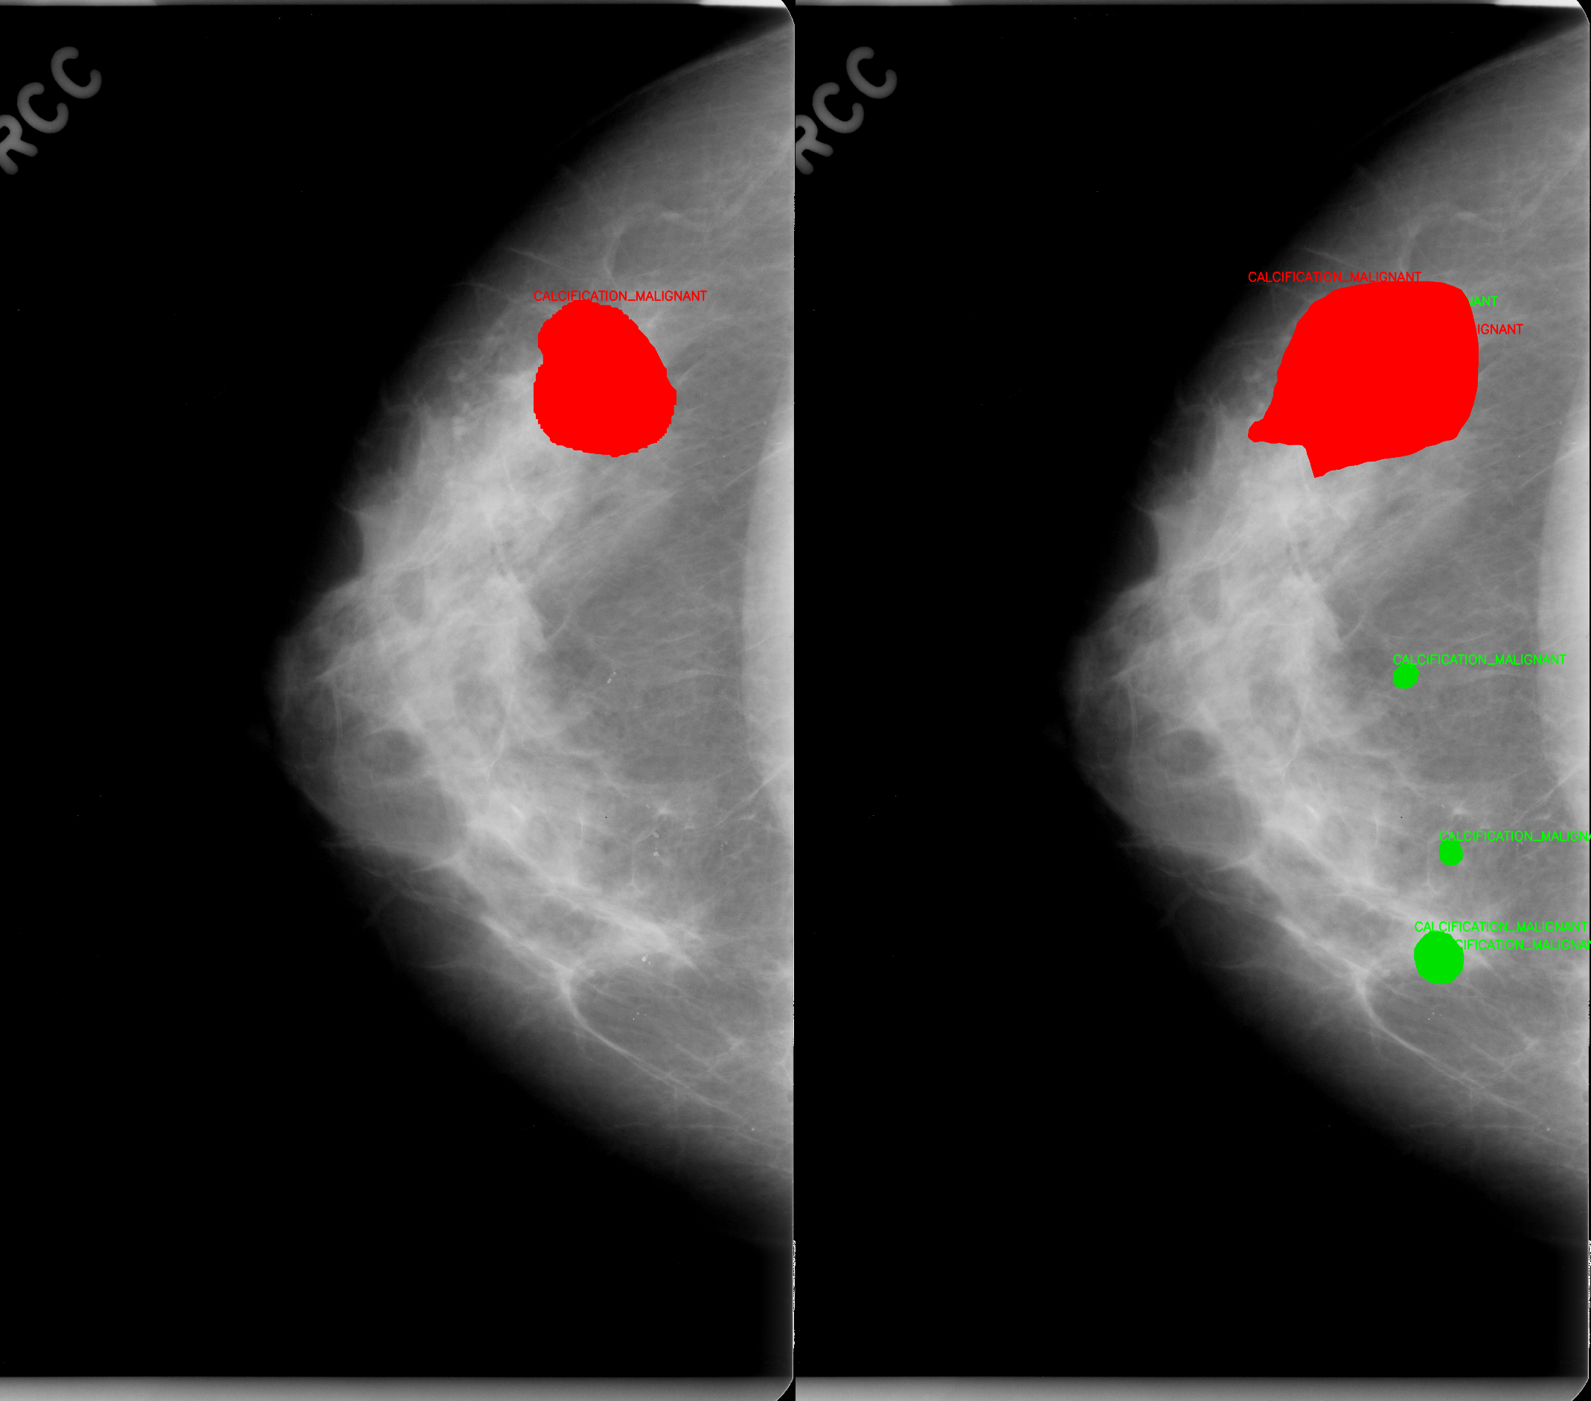
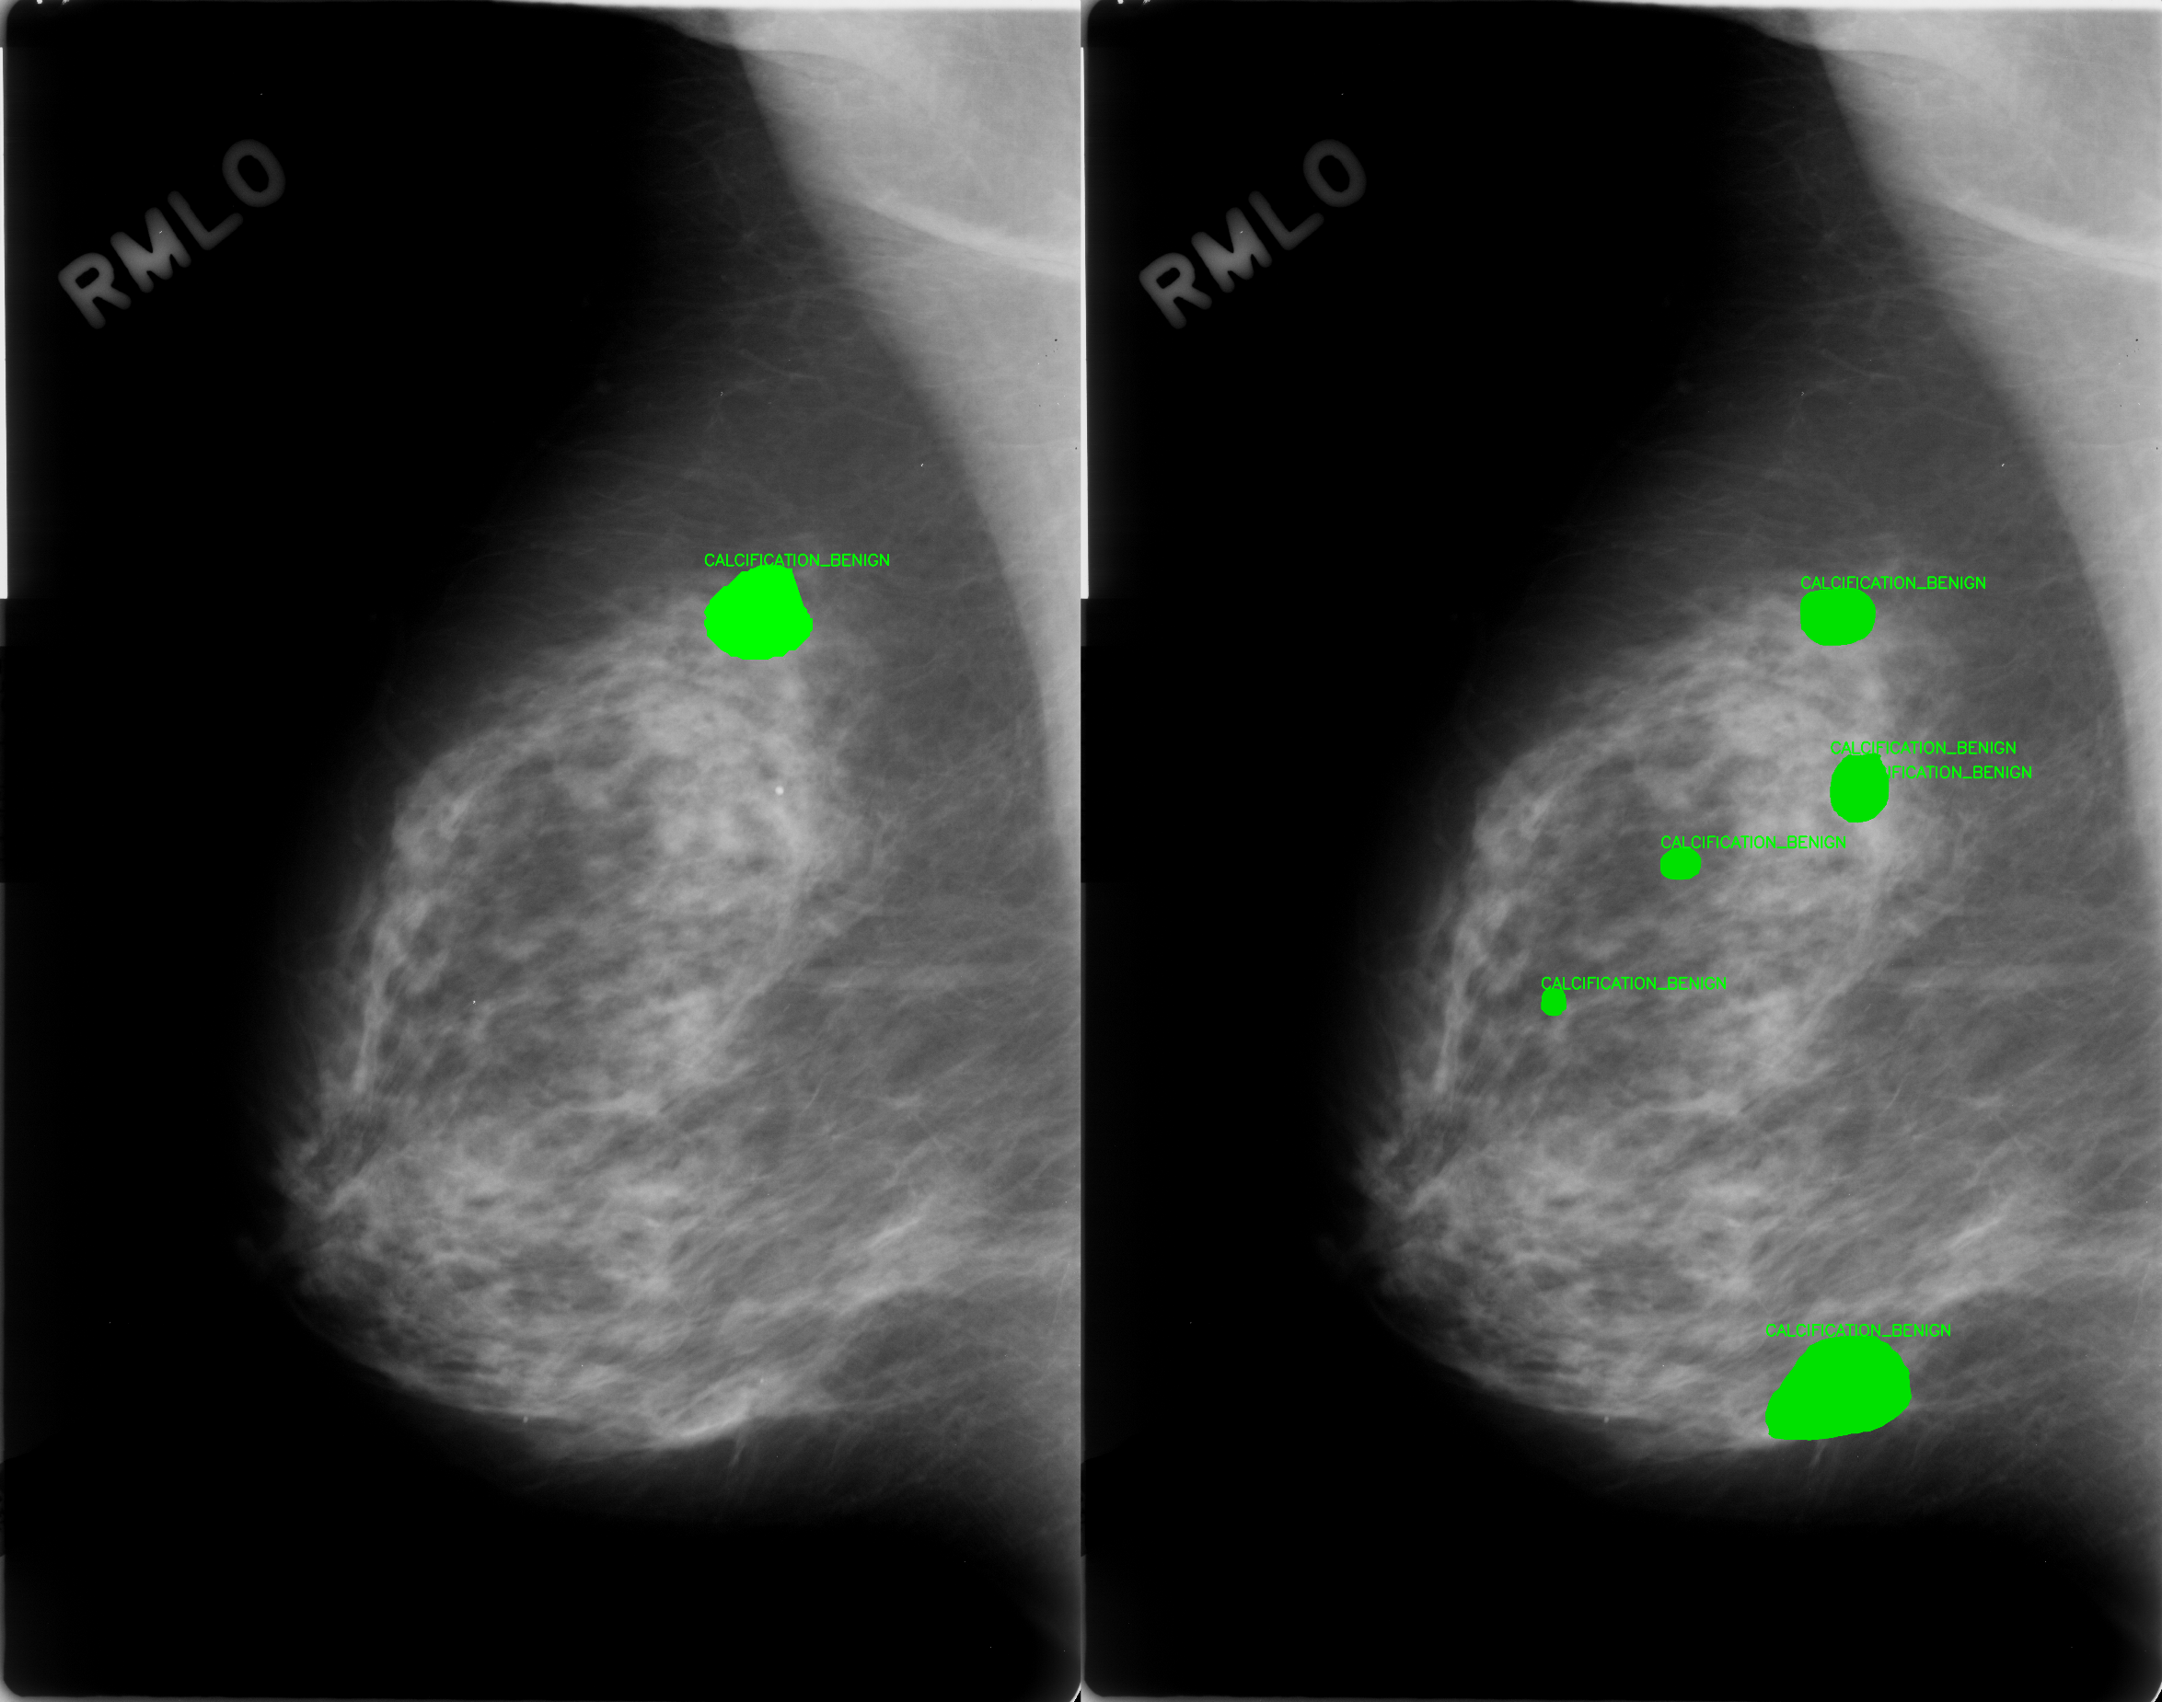
Results – Visualization

Slide 25
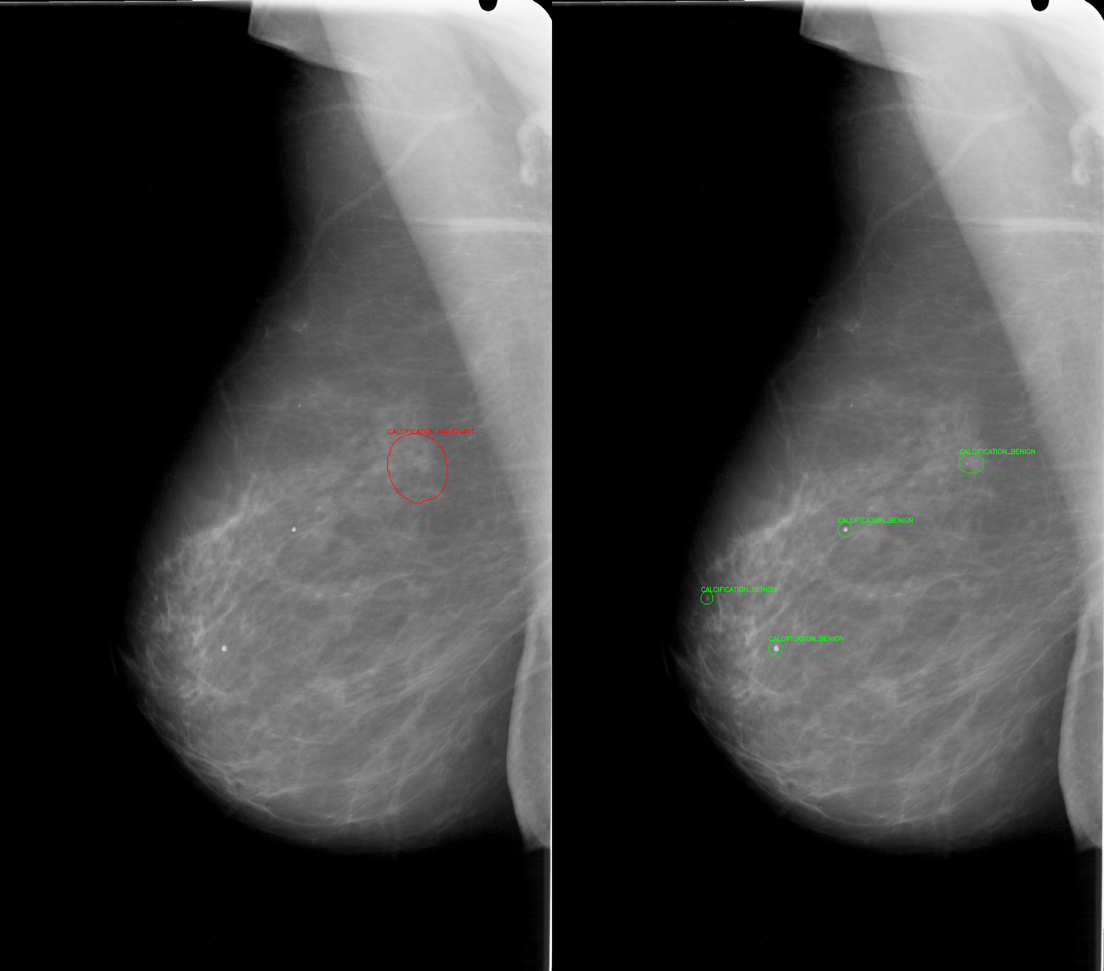
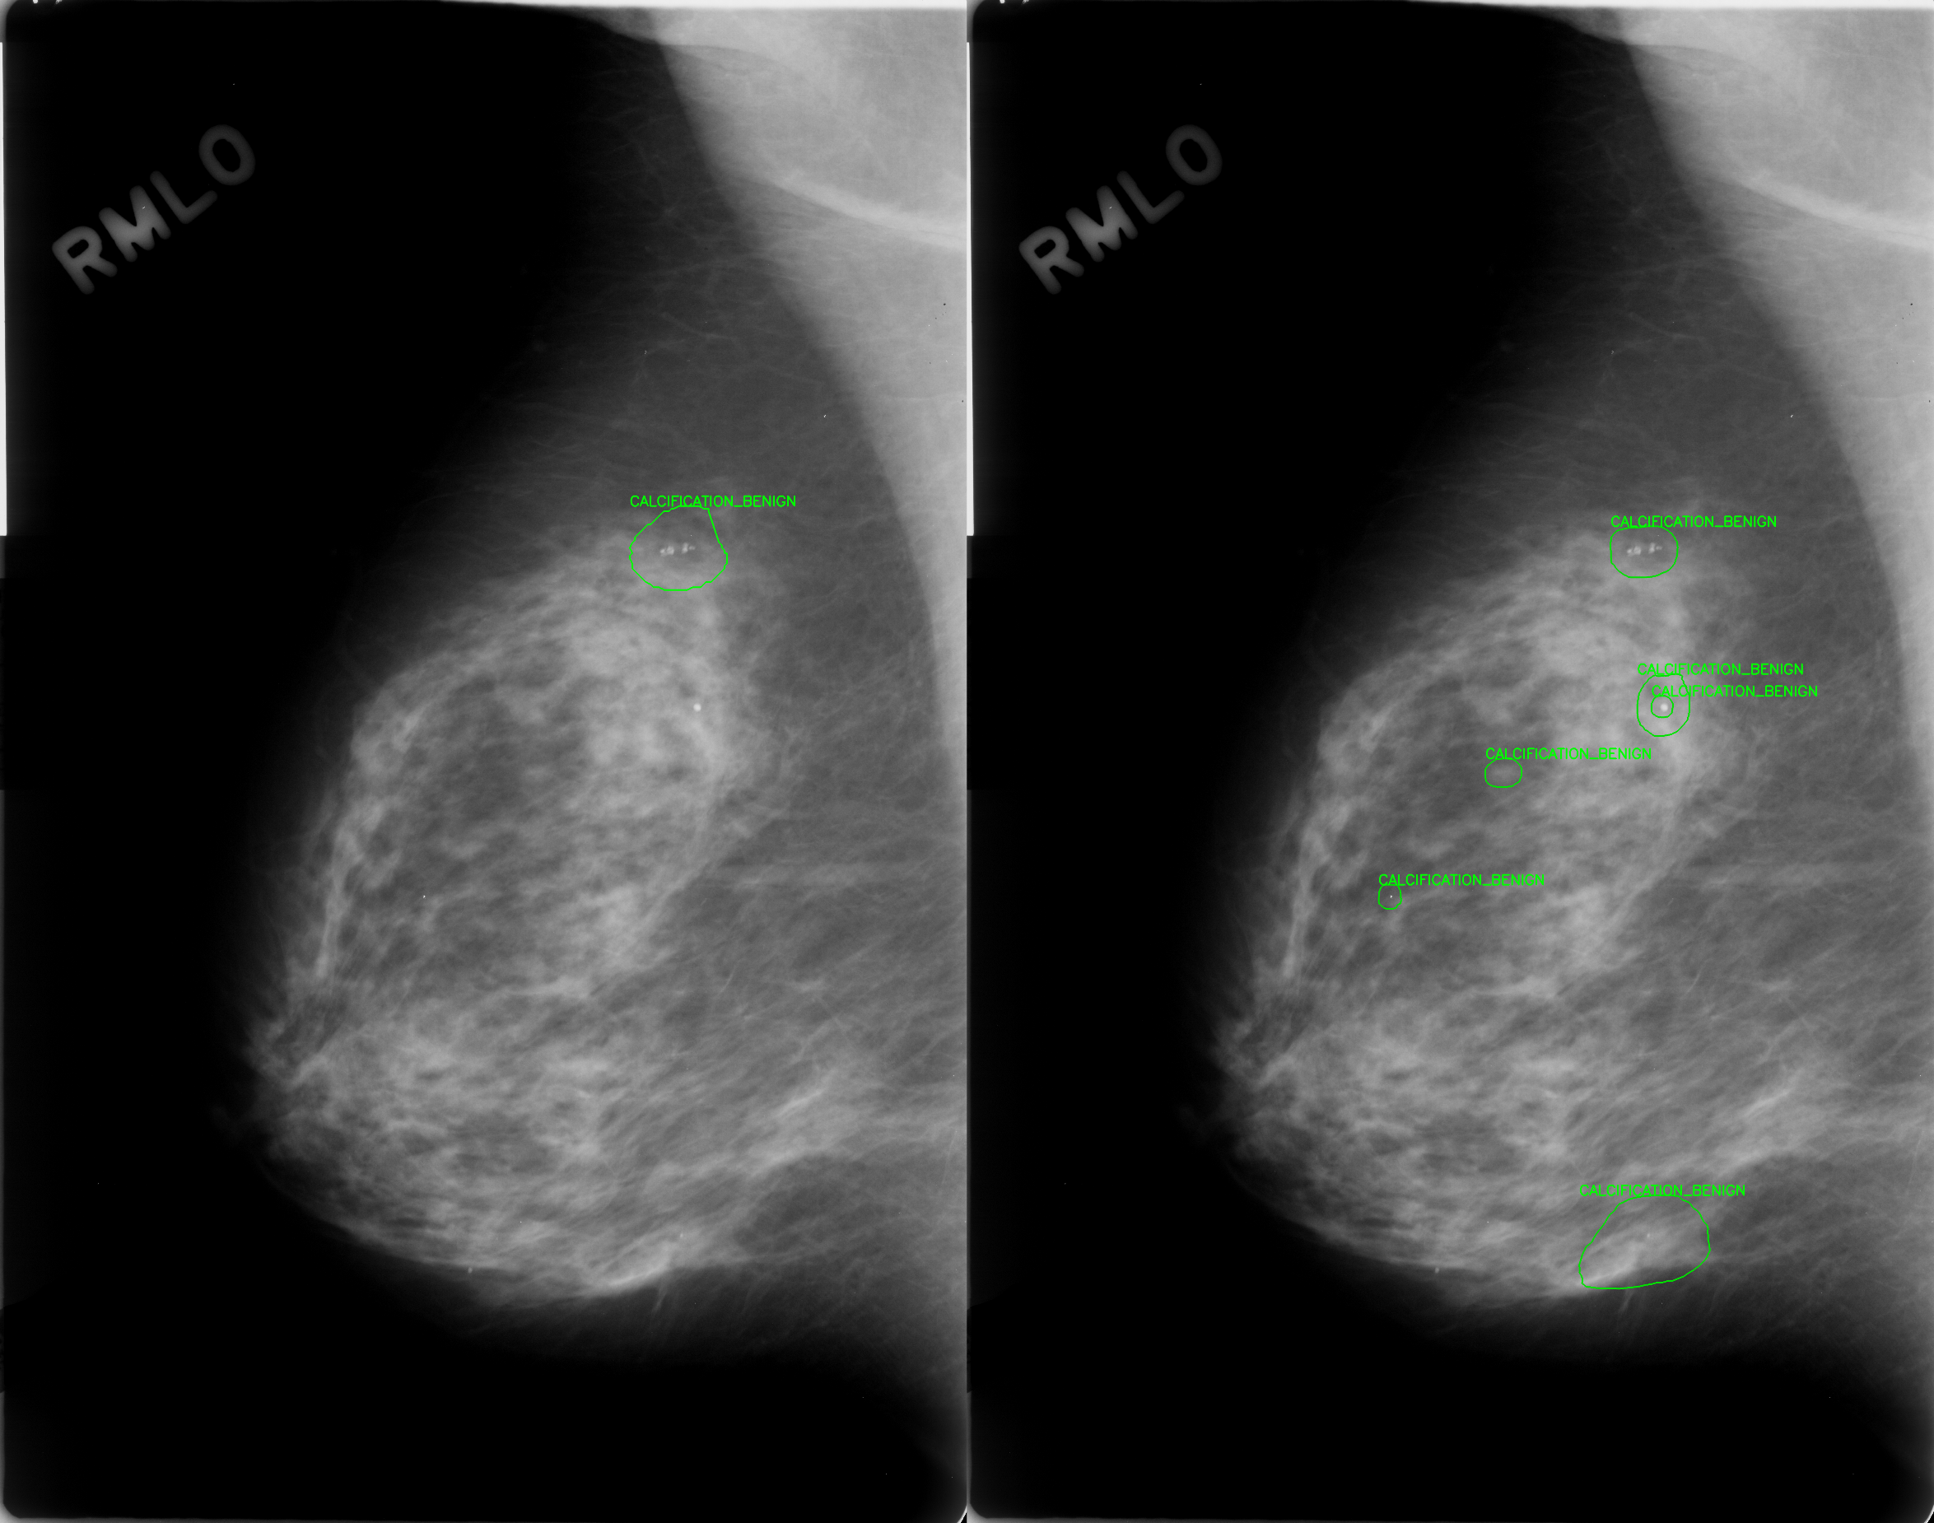
Results – Visualization

Slide 26
Future Work Possibilities
The segmentation model provided the baseline, which can be further optimized by trying a few following strategies:
Augmenting the dataset by using the Flipping, rotation to specific angles, and equalization histogram (CLAHE)
More epochs for learning, more samples for generalization
Merging multiple datasets – like CBIS-DDSM and VinDr-Mammo Dataset. VinDr-Mammo supports bounding box coordinates. Therefore, Polygons from CBIS-DDSM should be converted into BBOX before using this strategy.

